Slide 1
Syed Faizan
Used Car Sales Analysis

Slide 2
Data analysis of used car sales on CarDekho.com
Vehicles.csv
Exploratory Data Analysis (EDA)
Data cleaning and Feature Engineering
Analytical Questions
Hypothesis formulation and Testing
Linear Regression Modelling

Slide 3

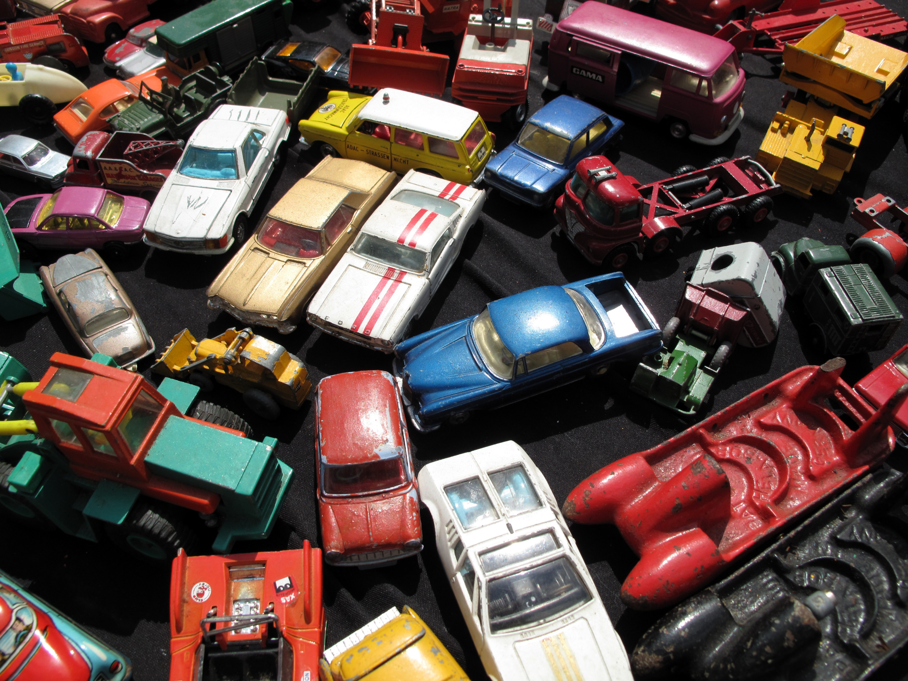
CarDekho.com is India’s largest online used car vendor
Our Dataset, having 8,128 rows and 13 columns of vehicle-related data was originally sourced from CarDekho.com.
Our Dataset spans the years 1994 to 2020.

Slide 4
Variables in the Dataset encompass both numerical and categorical variables
Name: The model of the vehicle.
Year: The year of manufacture.
Selling Price: The price at which the vehicle is being sold.
Km Driven: The total kilometers driven by the vehicle.
Fuel: The type of fuel used by the vehicle (e.g., Diesel, Petrol).
Seller Type: The type of seller (e.g., Individual, Dealer).
Transmission: The type of transmission (e.g., Manual, Automatic).
Owner: The ownership status (e.g., First Owner, Second Owner).
Mileage: The mileage offered by the vehicle.
Engine: The engine capacity.
Max Power: The maximum power of the vehicle.
Torque: The torque of the vehicle.
Seats: The number of seats in the vehicle.

Slide 5
Exploratory Data Analysis (EDA)
Used 5 number summaries and box-plots for all numerical variables.
Used Bar Charts to visualize Categorical Variables
Formed a general overview of the raw Dataset prior to Data Cleaning

Slide 6
Data Cleaning and Feature Engineering
Data Cleaning:
Row Cleaning: Rows with missing values expunged.
Renaming columns for Clarity
Measurement units dropped from ‘km’ & ‘engine’ and ‘model’ column extracted from ‘names’
Feature Engineering:
Column Refinement- “Max-Power” and “Torque” discarded.
Variables ‘mileage’ and ‘engine’ rendered numeric.
Logarithmic transform of ‘km’ and ‘price’
Column ‘Maruti’ created featuring ‘Maruti’ and ‘non-Maruti’ as entries.

Slide 7
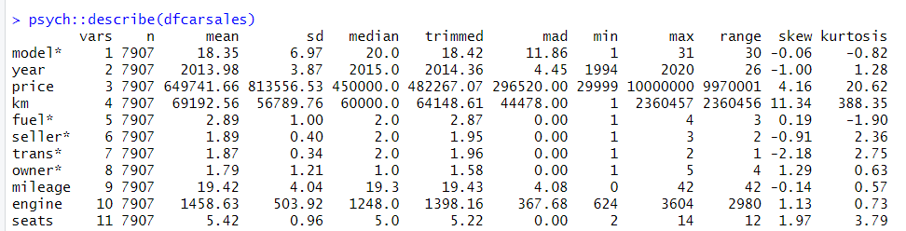
Overview of 5-number Summary of numerical variables
Know your material in advance
Anticipate common questions
Rehearse your responses
Maintaining composure during the Q&A session is essential for projecting confidence and authority. Consider the following tips for staying composed:
Stay calm
Mean Selling Price is Rs. 6,49, 741
Mean Kilometers driven is 69,192 kms
Mean Mileage is 19.42

Slide 8
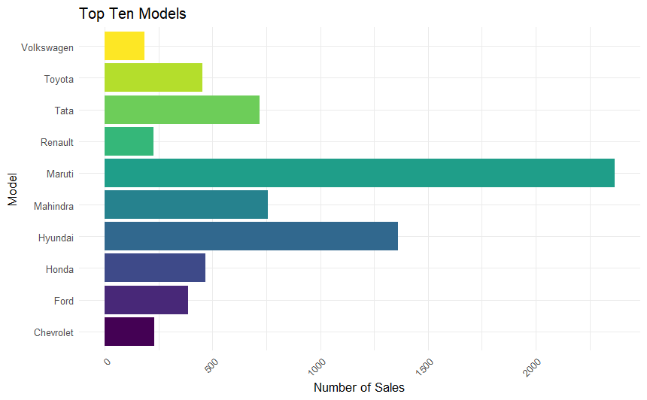
Maruti dominates the market Hyundai, Mahindra & Tata follow
Maruti is the best-selling model every year with the only exception being 1994, in which 'Ambassador' was the top-selling model.

Slide 9
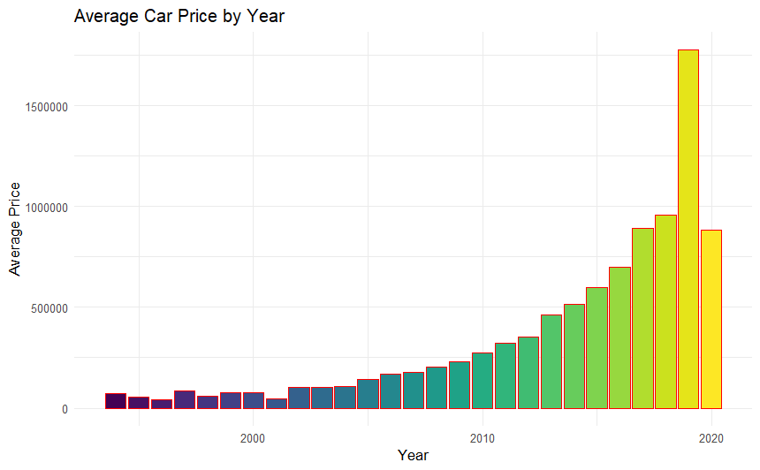
Impact of the Covid-19 Pandemic ?
A steep climb is observed in the average prices of the cars from 2000 to 2019.
The prices collapse in 2020.
Research is warranted on whether economic uncertainty of the Covid-19 Pandemic to be implicated in this price collapse.

Slide 10
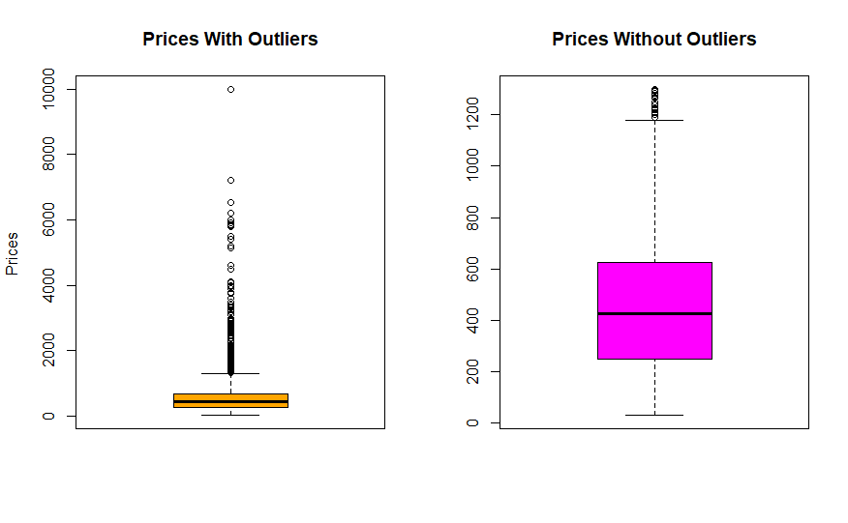
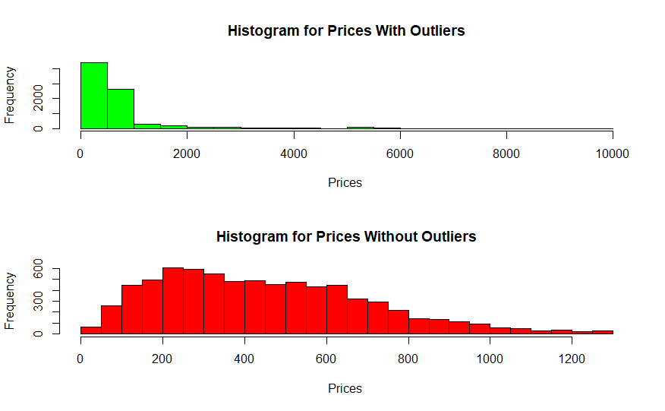
Luxury Car Models were Outliers for Selling Price

Slide 11
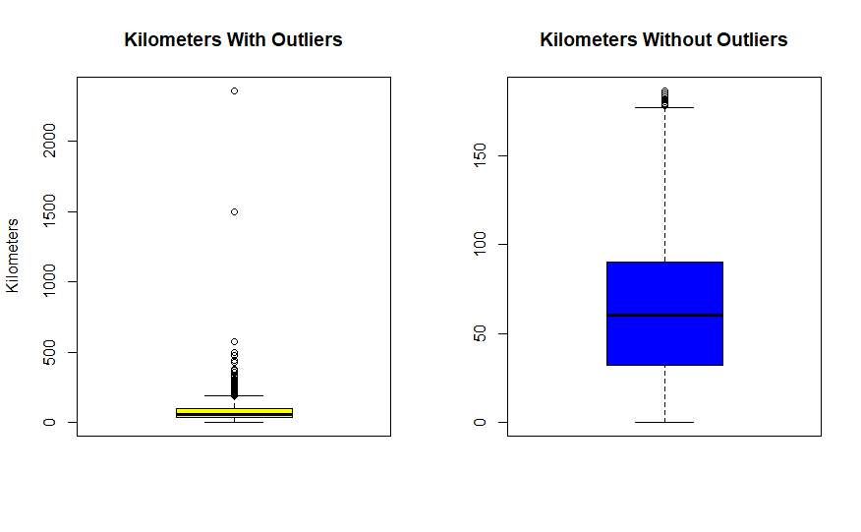
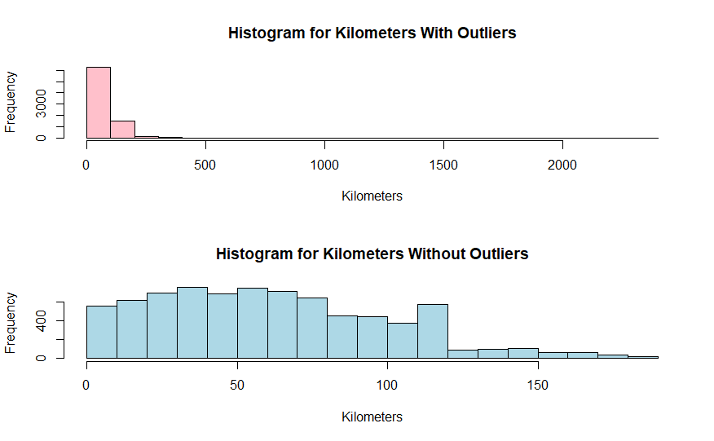
Significant Outliers had garnered a far higher kilometer count than other cars

Slide 12
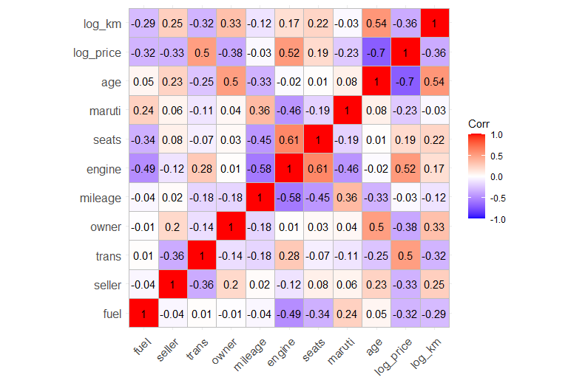
Correlations Examined (-1 to +1)
Older cars sell at a lower price in a robust negative correlation(-0.7).
Bigger the engine size better the selling price in a moderate correlation(0.52).
Older cars also tend have been driven more in a moderate correlation (0.50).
Cars with more seats have bigger engines.(0.61)

Slide 13
Analytical Questions framed and answers found
Question | Methodology | Answer | Relevance
Are used cars, that is, cars with more than one prior owner cheaper than cars with only a single owner? | T-Test | Yes | Price Stratification
Have cars sold by dealers been used more as compared to cars sold by individual private owners? | T-Test | No | Inventory valuation

Slide 14
More Analytical Questions and answers found
Question | Methodology | Answer | Relevance
Do diesel cars have a higher mileage as compared to the other fuel type cars ? | T-Test | Yes | Product Differentiation
Have automatic cars been used less as compared to cars with manual gear transmission? | T-Test | Yes | Market Segmentation

Slide 15
Why does Maruti dominate the used car market ?
Question | Methodology | Answer | Relevance
Do Maruti cars exhibit an advantage in terms of fuel efficiency (mileage) over non-Maruti cars? | T-Test | Yes | Brand positioning
Do Maruti cars present a pricing advantage among the cars? | T-Test | Yes | Cost Leadership

Slide 16
What is the nature of the cars that are driven more?
Question | Method | Answer | Relevance
Do diesel cars and petrol cars have a significant difference in terms of kilometers driven? | Two sample T-Test | Diesel cars have been driven more | Usage Segmentation
Is there is a statistically significant difference in the average number of kilometers driven between small and medium-sized cars? | Two sample T-Test | Medium sized cars are driven more | Size Differentiation

Slide 17
Best Multiple Regression model in terms of Adjusted R Squared (0.795) had the following independent variables
Variable | Type | Variable
Engine | Individual
Age | Individual
Mileage | Interacting with | Log of Kilometers driven
Engine | Interacting with | seats
Engine | Interacting with | Log of Kilometers driven
Engine | Interacting with | Age
Log of Kilometers driven | Interacting with | Seats
Age | Interacting with | Seats

Slide 18
Insights from Regression models
Intuitive findings
For each percent increase in kilometers driven, the selling price is expected to decrease by 0.27%.
Each additional year in a car’s age is associated with a decrease in selling price by Rs. 59,266, .
For each unit increase in engine size, the selling price increases by approximately Rs. 446.
Counterintuitive finding
Each additional unit increase in mileage (fuel efficiency) is associated with an average decrease of Rs. 15,350 in selling price. This is counterintuitive but may be explained by preference for luxury vehicles or market segment and vehicle type.

Slide 19
Thank you

